Slide 1

cloud to next level
Cloud AWS 3-Tier Application Trainee Project

Slide 2
Agenda
About Project
Architectural Diagram
Implementation Steps
Future Work

Slide 3

About Project
cloud to next level
01.

Slide 4
Introduction to the Website
WordPress-based customer service platform
Designed to be scalable, secure, and resilient
Deployed on AWS with best practices in cloud architecture

Slide 5
WordPress 3-Tier Application
Web Tier
Application Load Balancer (ALB) in public subnets
Handles incoming HTTP/HTTPS requests
Distributes traffic to EC2 instances
2. Application Tier
EC2 instances running WordPress
Managed by Auto Scaling Group for elasticity
Amazon EFS for shared file storage across instances
3. Database Tier
Amazon RDS (MySQL) for persistent data
Securely placed in private subnet
Stores WordPress content, users, and settings

Slide 6
Architectural Diagram
cloud to next level
02.

Slide 7
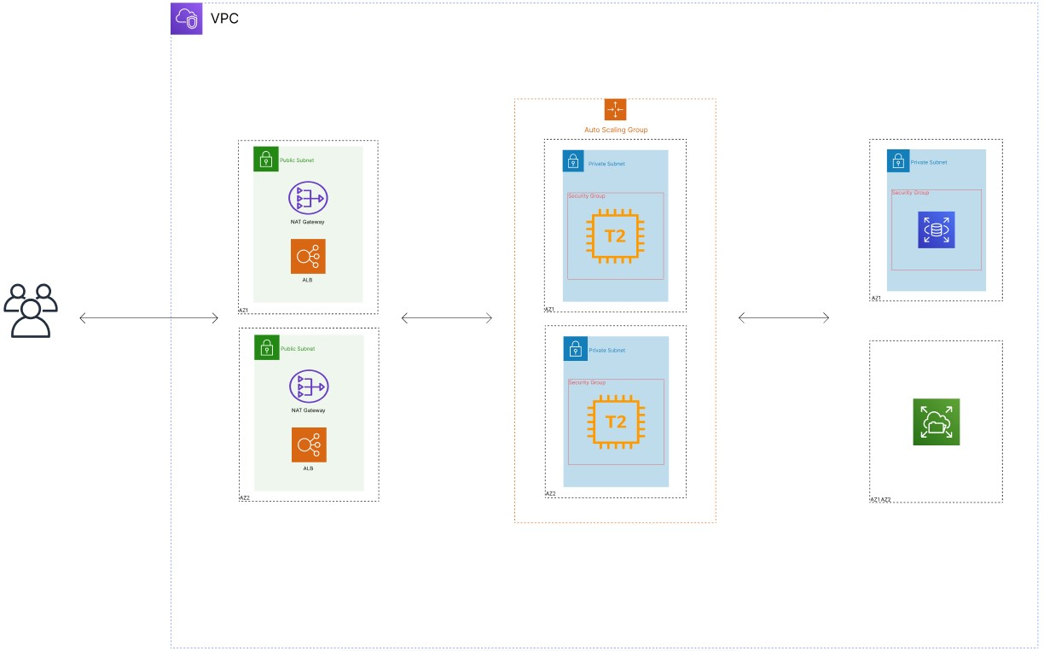
High Level Architectural Diagram

Slide 8
Implementation Steps
cloud to next level
03.

Slide 9
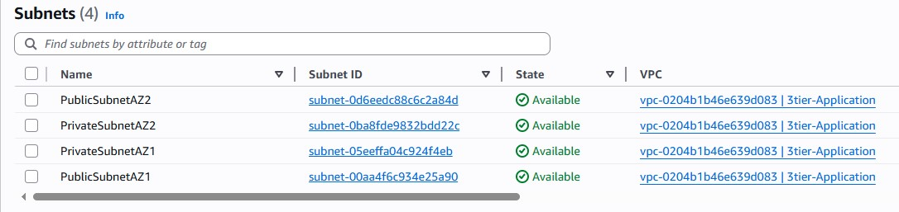
Implementation Steps
VPC & Subnets: Create VPC with 2 public + 2 private subnets across 2 AZs

Slide 10
Internet Gateway & NAT
Enable outbound access for Private subnets and Public subnets

Slide 11
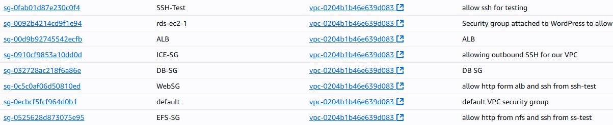
Security Groups
Configure ALB, EC2, and RDS… inbound/outbound rules

Slide 12
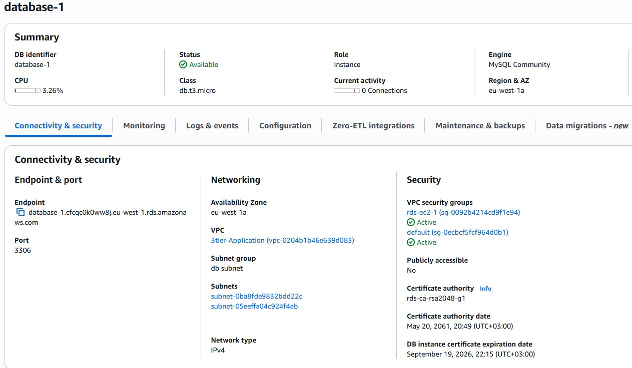
RDS Setup
Deploy MySQL database in private subnet

Slide 13
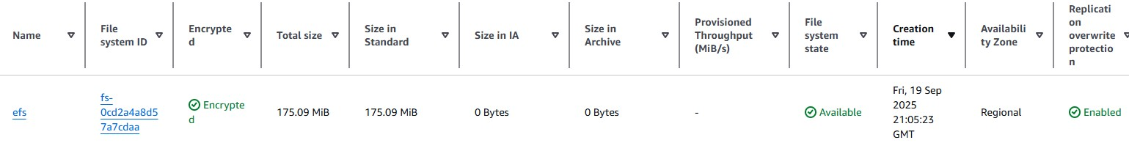
EFS Setup
Create and configure shared storage for WordPress uploads

Slide 14
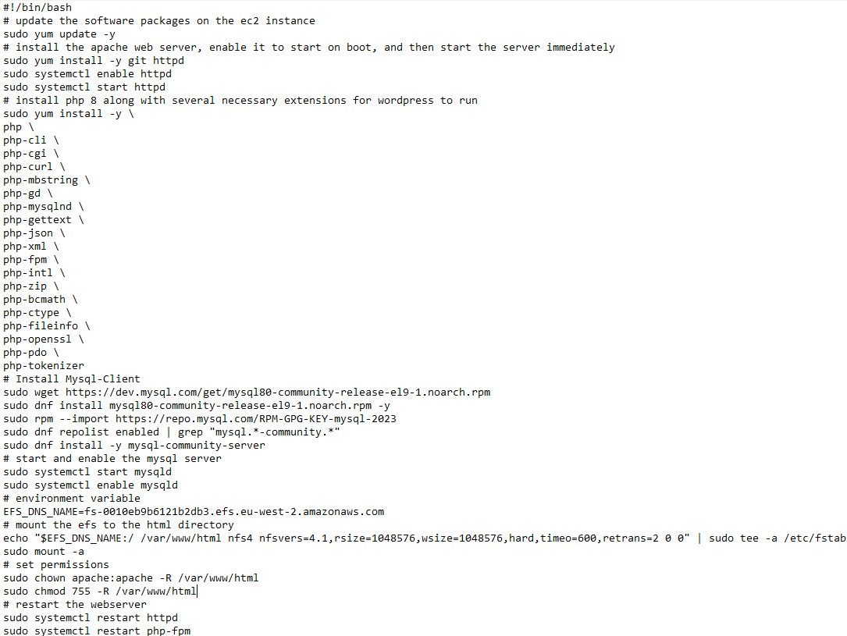
ICE Instance Setup Script
Setup the database using credentials using test instance and mount the ec2 to the EFS for testing

Slide 15
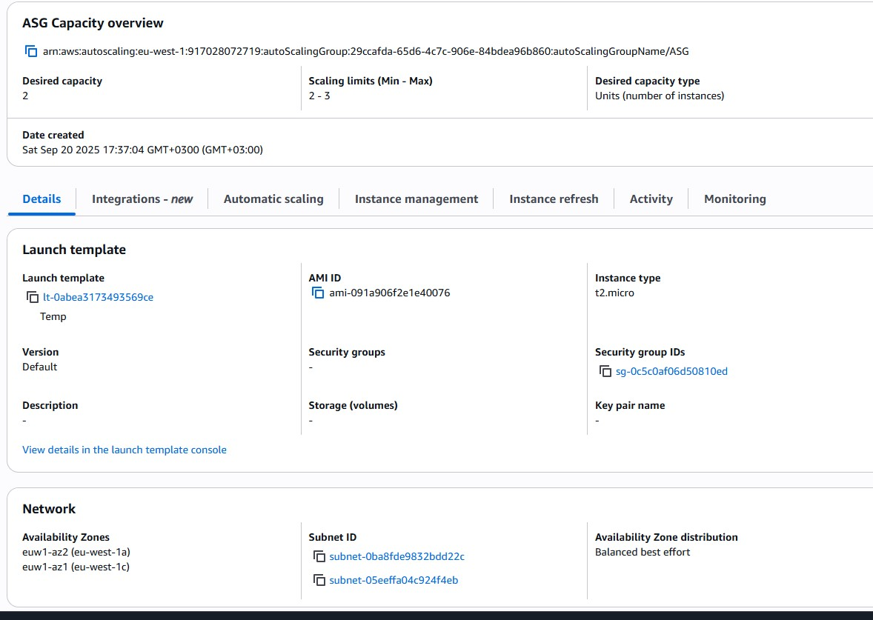
ASG Setup
Setting up the ASG with the appropriate settings

Slide 16
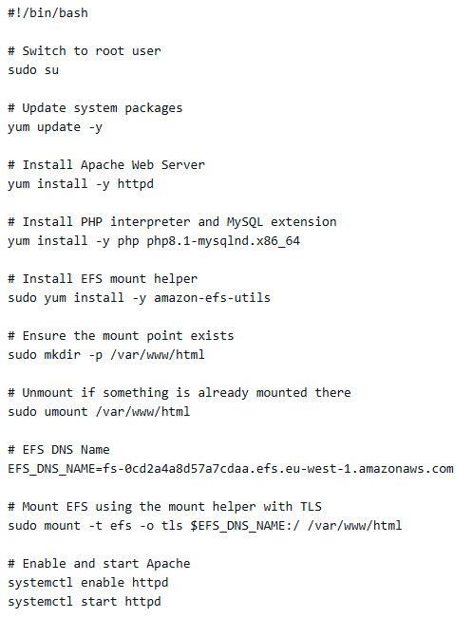
Launch Template User Data

Slide 17
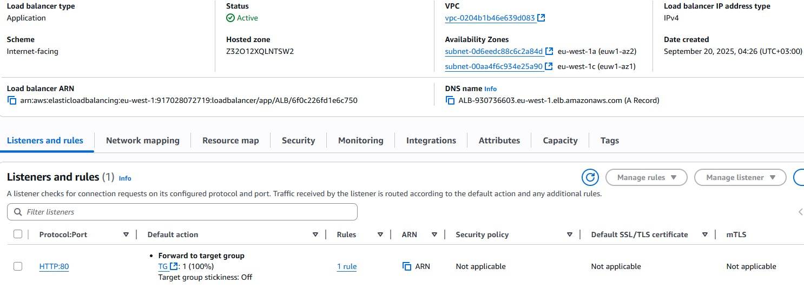
Application Load Balancer

Slide 18
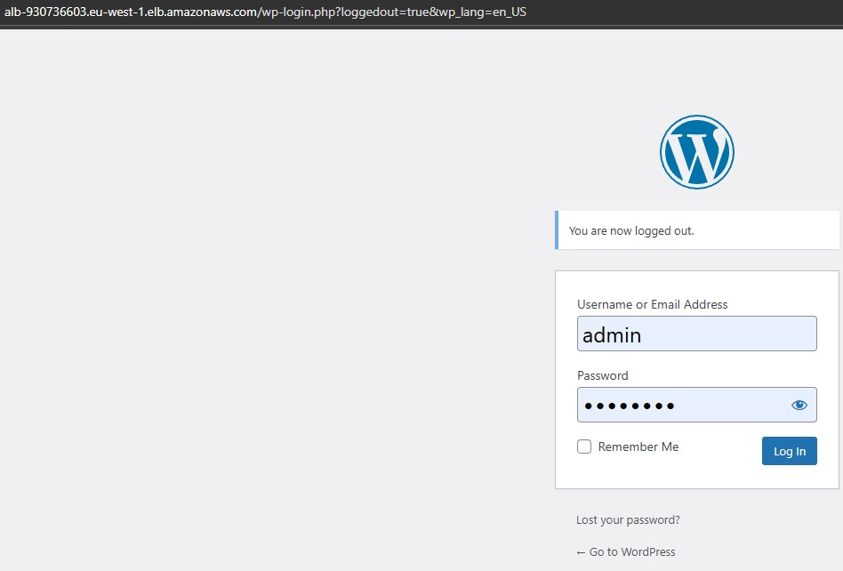
WordPress Login Page

Slide 19
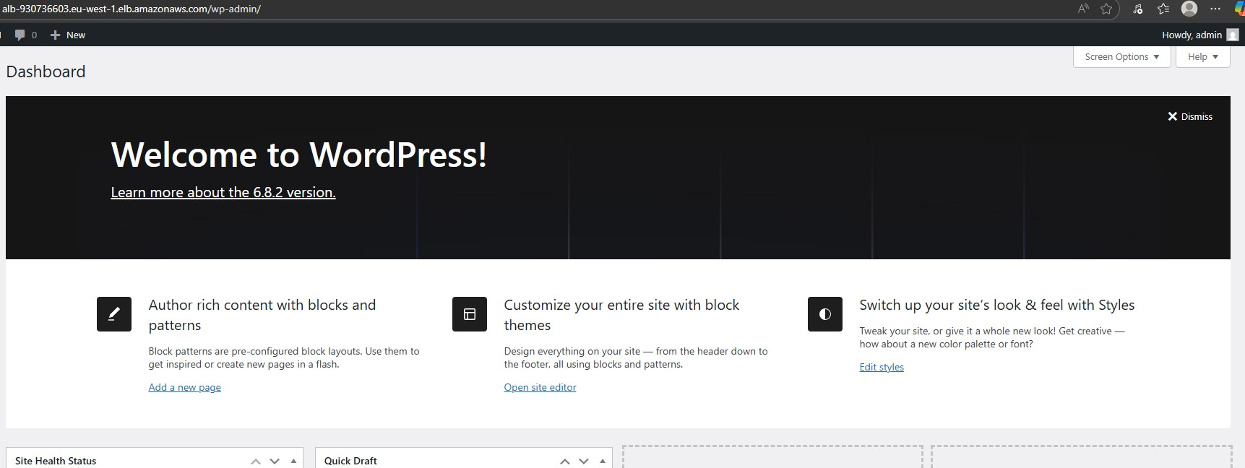
WordPress Main Page

Slide 20
Future Work
cloud to next level
04.

Slide 21
Future Work
Enable RDS Multi-AZ for higher availability and database fault tolerance.
Integrate Auto Scaling with SNS to send email alerts when instances are launched or terminated
Add CloudFront + Route 53 for HTTPS, global content delivery, and DDoS protection
Enhance Security with AWS WAF and Secrets Manager for safer credentials management

Slide 22
THANK YOU

